Slide 1
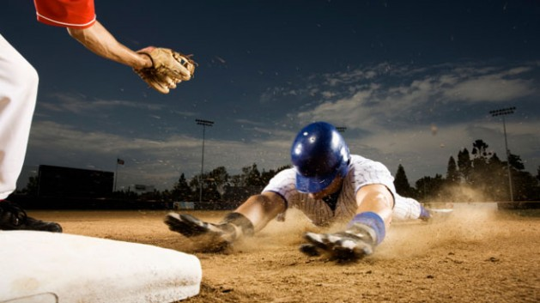
Stealing Bases
Presented by:
Mireille Nehme
Nathalie ouellette
Samuel van noppen
Wyatt Baldwin

Slide 2
Content
BAseball Overview
Goal
Data
Technologies & tools
Analysis
Results
Future analysis
https://www.stack.com/a/base-stealing/

Slide 3
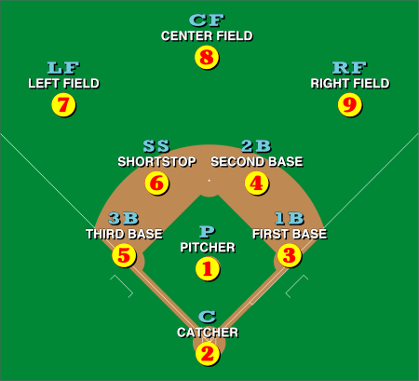
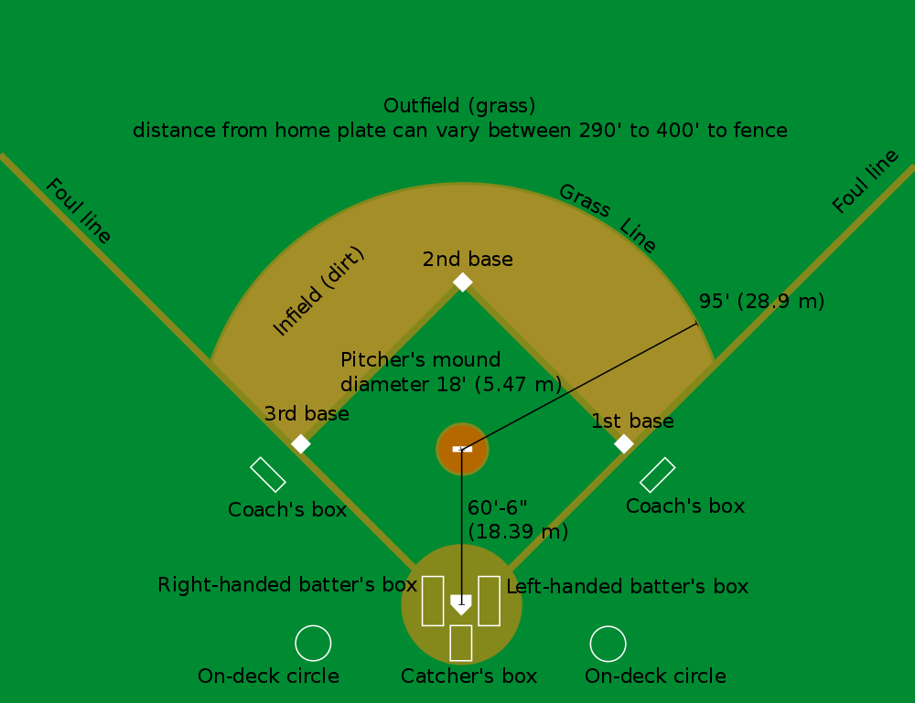
Baseball overview
https://en.wikipedia.org/wiki/Baseball_field
1st strike, 2nd strike, 3rd strike
And you’re out !!
Notes:
9 players per team

Slide 4
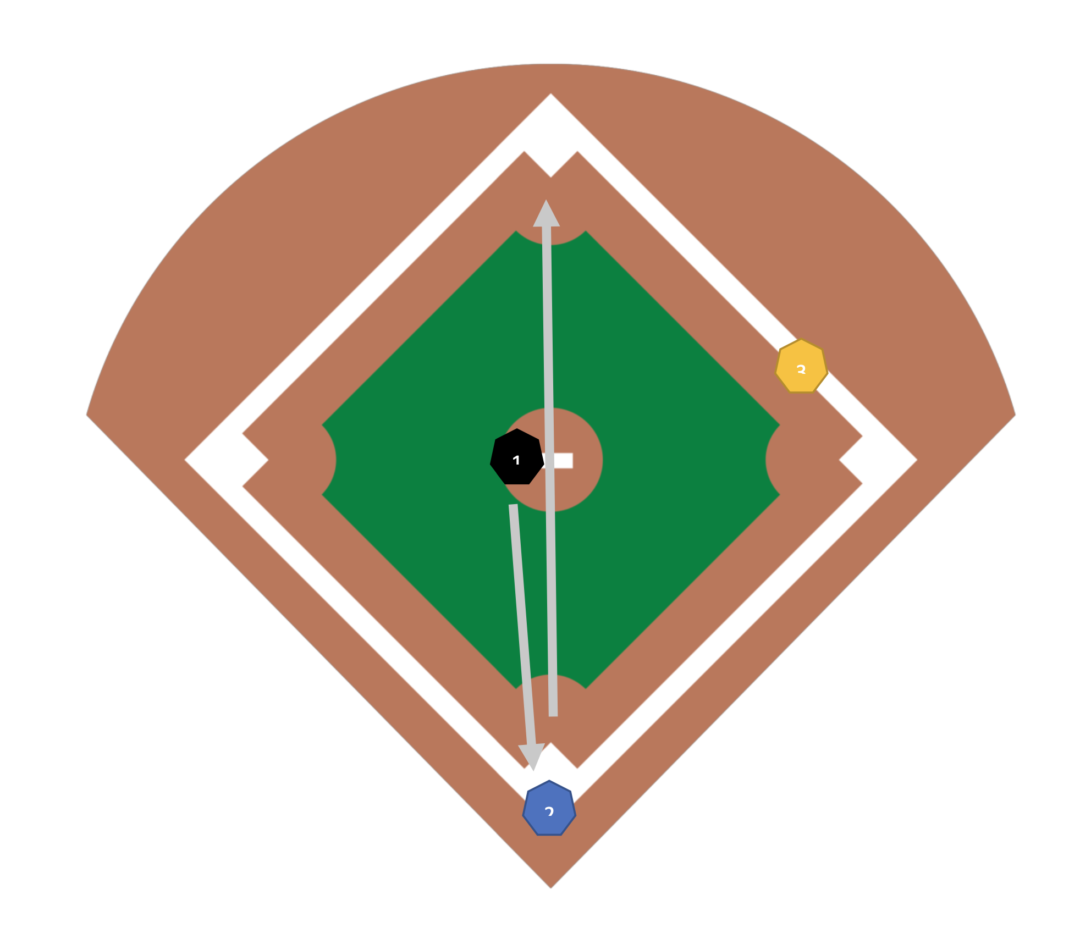
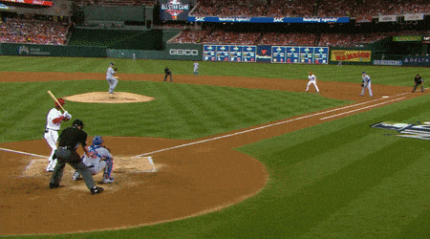
Stealing Bases
https://gfycat.com/gleamingickyhorsemouse
Notes:
9 players per team

Slide 5
Goal
Can a machine learning model accurately predict whether an MLB runner will be able to successfully steal a base based on their running speed, the pitcher's average pitch speed, and the catcher's pop time?

Slide 6
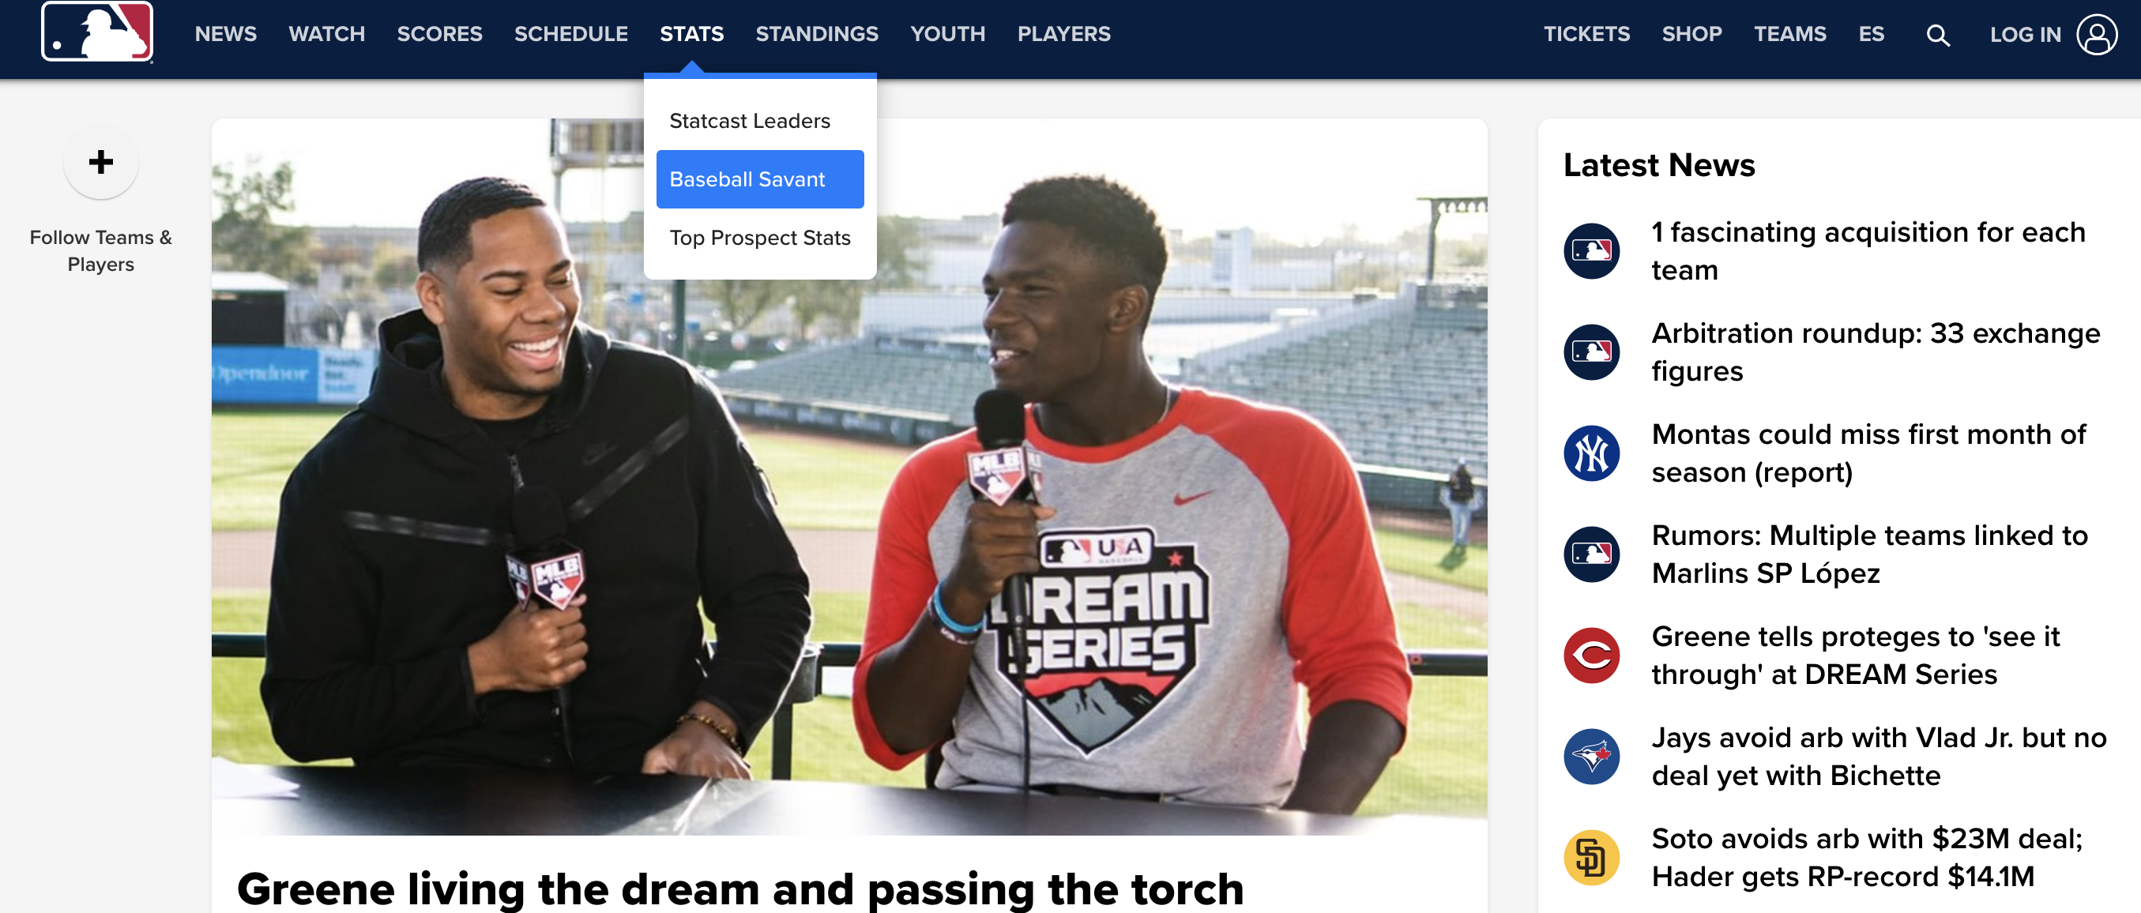
Data
Data source: https://www.mlb.com/

Slide 7
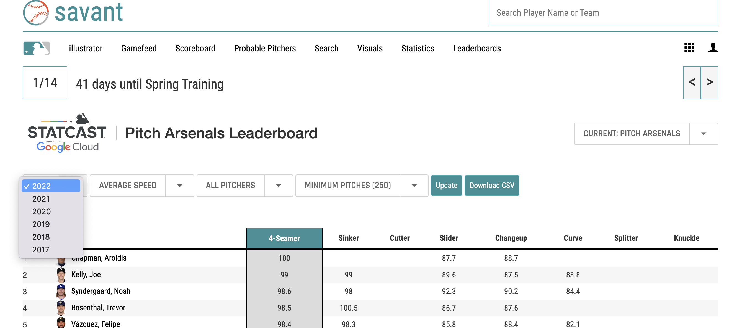
Data – 1st Dataset
Pitchers table

Slide 8
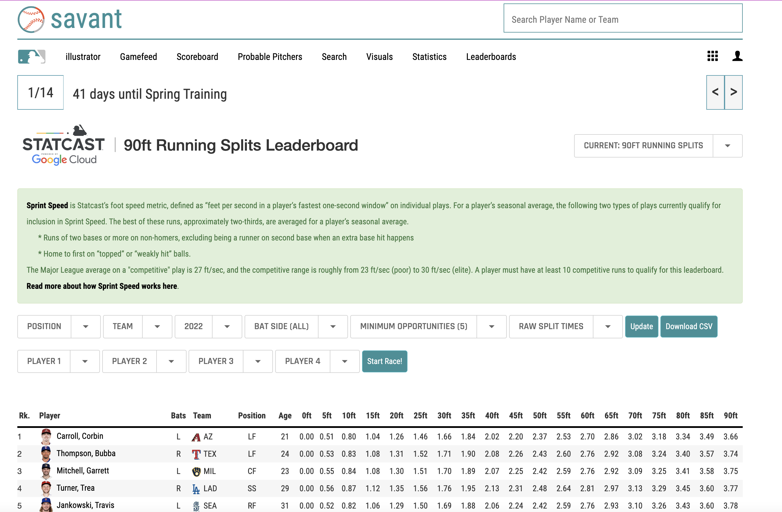
Data – 2nd Dataset
Running splits table

Slide 9
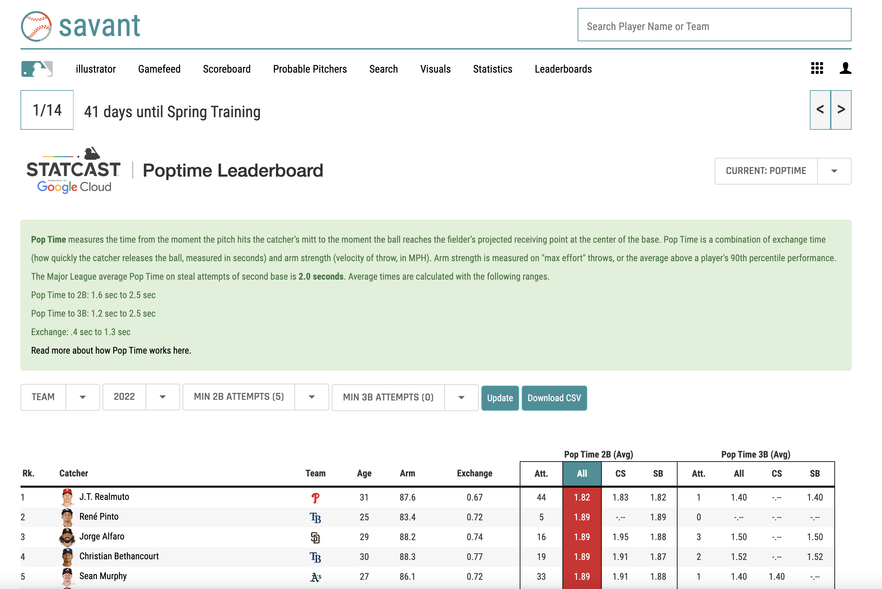
Data – 3rd Dataset
Poptime table

Slide 10
Data
Data description

Slide 11
Analysis

